Slide 1

A Project Report on
Shelf Track: Intelligent Empty Shelf and Low-Stock Monitoring System
submitted in the partial fulfillment of the requirements for the award of the degree of
BACHELOR OF TECHNOLOGY
in
ARTIFICIAL INTELLIGENCE & MACHINE LEARNING
by
UDYAVARA UDAY SHANKAR 212G1A3953
G. NIJAMUDDIN 212G1A3912
KALINGA GURUKIRAN 212G1A3929
BOLLINENI YASWANTH 212G1A3908
M. KAVITHA 212G1A3935
Under Supervision of
Dr. K. BHARGAVI _{M.Tech, Ph.D}
Associate Professor & HOD, Department of Computer Science and Engineering
ANANTHA LAKSHMI INSTITUTE OF TECHNOLOGY AND SCIENCES
Approved by AICTE, New Delhi & Affiliated to J.N.T.U. Ananthapuram, Accredited by
NAAC Near S.K. University, Itikalapally(V), Anantapur (Dt) – 515 721.A.P.

Slide 2
CONTENTS
1. Abstract
2. Introduction
3. Existing Systems
3.1 Disadvantages
4. Proposed Systems
4.1 Introduction
4.2 Objectives
4.3 Advantages
4.4 Software and Hardware Requirements
4.5 System Architecture
4.6 Proposed System Algorithms
5. System Design
5.1 DFD Diagram
5.2 Use Case Diagram
5.3 Sequence Diagram
6. Testcases
7. Results
8. Conclusion
9. References

Slide 3
1. ABSTRACT
Recent research in inventory management has explored various computer vision and deep learning techniques to automate shelf monitoring and stock level estimation. Prior studies have demonstrated the feasibility of using image processing and object detection models to enhance retail operations, paving the way for more integrated and automated systems.
Current systems primarily rely on traditional image processing methods to detect missing items on shelves. These approaches generally focus on identifying individual products and often require manual verification, limiting the scalability and efficiency of inventory management in dynamic retail environments.
Despite their utility, existing systems face significant challenges. They often raise customer privacy concerns due to direct image processing, lack precise identification of empty shelf regions, and do not effectively detect low inventory levels. This results in inefficiencies and delays in inventory replenishment and strategic decision-making.
The proposed solution, "Shelf Track," overcomes these limitations by integrating advanced technologies such as Faster R-CNN for detecting empty shelf regions and a hybrid OCR-CNN model for precise item labeling and low-stock detection. In addition to real-time inventory tracking, the system generates comprehensive monthly reports, providing actionable insights and trend analyses to support strategic management decisions while maintaining a privacy-centric approach.

Slide 4
2. INTRODUCTION
In today’s fast-paced retail environment, manual inventory checks are inefficient and error-prone, leading to missed sales opportunities and increased operational costs. By leveraging advanced technologies like Faster R-CNN, CNN, OCR, and data analytics, our system automates shelf monitoring and inventory management while ensuring customer privacy.
Faster R-CNN:
Utilizes deep learning with a ResNet-50 backbone to efficiently detect empty shelf regions through region proposal networks, ensuring precise localization and rapid detection.
Convolutional Neural Networks (CNNs):
Analyzes product images to determine stock quantities by comparing current levels against predefined thresholds, enabling scalable and automated inventory tracking.
Optical Character Recognition (OCR):
Reads product labels and barcodes directly from shelf images, providing accurate identification of items and ensuring targeted restocking actions.
Data Analytics:
Aggregates stock trends and low inventory incidents over time, generating comprehensive monthly reports that offer actionable insights and support strategic decision-making.

Slide 5
3. EXISTING SYSTEMS
Retailers have traditionally relied on manual inspections and basic image processing techniques, such as CCTV monitoring and RFID tagging, for inventory management. These established methods, while widely implemented, often involve labor-intensive processes and static approaches that are not fully optimized for today's fast-paced retail environments.
3.1 Disadvantages of Existing Systems:
High Labor Costs
Delayed Inventory Updates
Limited Scalability & Adaptability
Inconsistent Performance
Lack of Real-Time Insights

Slide 6
4. PROPOSED SYSTEMS
4.1 Introduction
The proposed system utilizes a pre-trained Faster R-CNN model, integrating CNN and ResNet-50 architecture, to detect empty shelves in retail stores. Unlike traditional methods that require continuous real-time monitoring, this approach effectively identifies shelf shortages while ensuring customer privacy is not compromised.
By leveraging deep learning techniques, the system processes images from store shelves to recognize empty spaces and alert store managers. This enhances inventory management efficiency, reduces manual labor, and optimizes restocking strategies.
Advanced Deep Learning
Automated Alerts
Enhanced Operational Efficiency
Optimized Restocking Strategies
Real-Time Monitoring & Reporting

Slide 7
4.2 Objectives
Objective 1: Accurate Empty Shelf Detection
Real-Time Detection
High Accuracy
Optimized Preprocessing
Objective 2: Automated Inventory Monitoring & Restocking
Continuous Tracking
Automated Alerts
Actionable Insights

Slide 8
4.4 Software and Hardware Requirements
4.3 Advantages
High Accuracy
Cost-Effective
Enhanced Privacy.
Real-Time Insights
Scalable Solution
Optimized Workflow
Hardware: Intel Core i5 1TB Hard Disk 14-inch Colour Monitor Optical Mouse (Input Device) 8GB RAM | Software: Operating System: Windows 10 Coding Language: Python Front-End Designing: HTML, CSS, JavaScript

Slide 9
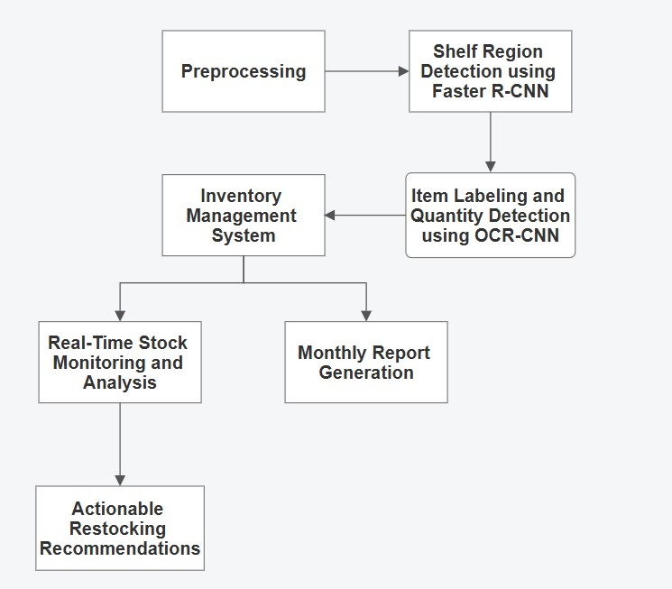
4.5 System Architecture
Preprocessing:
Images are cleaned, resized, and enhanced (contrast adjustment, noise reduction) for improved clarity.
Shelf Region Detection:
A pre-trained Faster R-CNN model with Region Proposal Networks (RPNs) identifies empty shelf regions.
Item Labeling & Quantity Detection:
An OCR-CNN module extracts product labels and estimates quantities from the shelf images.
Inventory Management System:
Processes detected shelf data to monitor stock levels and identify restocking needs.
Real-Time Monitoring & Alerts:
Continuously tracks stock availability and triggers alerts when empty shelves are detected.
Monthly Report Generation:
Summarizes stock availability and sales trends for detailed analysis.
Actionable Restocking Recommendations:
Provides timely suggestions to optimize shelf replenishment strategies.
Fig 4.1 System Architecture

Slide 10
4.6 Proposed Systems Algorithms
Empty Shelf Detection Using Faster R-CNN Algorithm
Algorithm
Input: ShelfImage Output: DetectedEmptyRegions 1. Preprocess(ShelfImage): Resize image to a standard resolution (e.g., 512x512). Enhance contrast and reduce noise. Return ProcessedImage. 2. Regions ← FasterRCNN(ProcessedImage): Use Region Proposal Network (RPN) to propose potential empty regions. Classify each region as empty or not empty. Return Regions containing empty shelf areas. 3. If Regions is not empty: Alert = "Empty Shelf Detected" Store empty region coordinates for further analysis Else: Alert = "No Empty Shelf"

Slide 11
Shelf Inventory Recognition Algorithm
Algorithm
Input: ShelfImage, Regions Output: LabeledItems, StockLevels 1. For each region in Regions: Extract RegionOfInterest (ROI) from ShelfImage. TextData = OCR(ROI): i. Preprocess ROI for OCR. ii. Apply OCR-CNN for text extraction. iii. Post-process extracted text. ItemLabel = IdentifyProduct(TextDta) Quantity = EstimateQuantity(ROI, CNNModel) LabeledItems.append(ItemLabel) a StockLevels[ItemLabel] = Quantity 2. Return LabeledItems, StockLevels

Slide 12
Automated Inventory Management System
Algorithm
Input: LabeledItems, StockLevels Output: UpdatedInventory, RestockRecommendations 1. For each item in LabeledItems: current_stock = Database.getCurrentStock(item) new_stock = current_stock + StockLevels[item] Database.updateStock(item, new_stock) 2. For each item in Database: if item.stock < item.threshold: RestockRecommendations.append(item) 3. Send RestockRecommendations to StoreManager 4. Return UpdatedInventory, RestockRecommendations

Slide 13
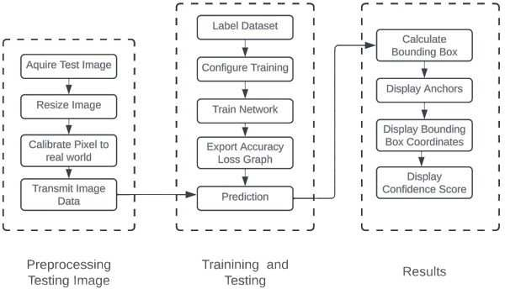
5. SYSTEM DESIGN 5.1 DFD Diagram
1. Preprocessing Testing Image
Aquire Test Image
Resize Image
Calibrate Pixel to Real World
Transmit Image Data
2. Training and Testing
Label Dataset Configure Training Hyperparameter Tuning
Train Network CNN-based Models:Faster R-CNN
Export Accuracy/Loss Graph
Prediction Model Inference using trained network
3. Results
Calculate Bounding Box Bounding Box Regression
Display Anchors Anchor Box Algorithms – Faster R-CNN
Display Bounding Box Coordinates Extracted from prediction
Display Confidence Score
Low Stock Notification Notify Store Manager if stock falls below threshold
Fig:5.1 Data flow diagram for Shelf Track

Slide 14
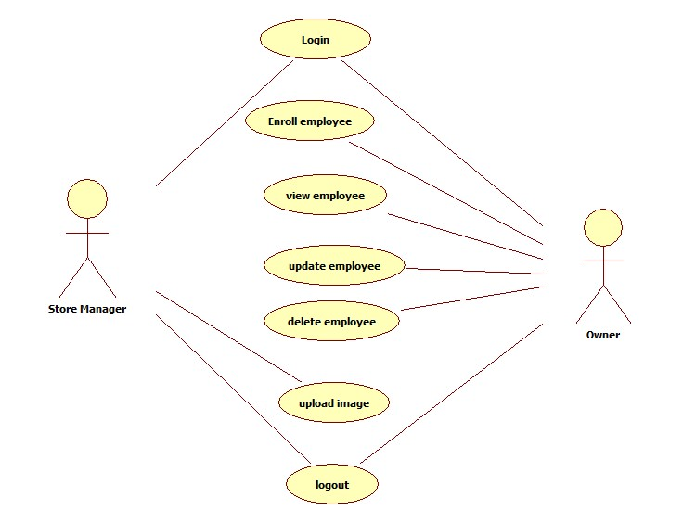
5.2 Use Case Diagram
Store Manager: ploads images, receives low stock notifications after image processing, and logs out.
Owner: Has overarching control, with the same or extended privileges to enroll, view, update, and remove employee records.
User Authentication:
Store Manager and Owner must log in to access any system features.
Employee Management:
Enroll Employee
View Employee
Update Employee
Delete Employee
Image Upload
Low Stock Notification
Logout
This structured approach ensures that each actor has role-specific access to system functionalities, maintaining an efficient and secure employee management process.
5.2 Roles of actors in the system

Slide 15
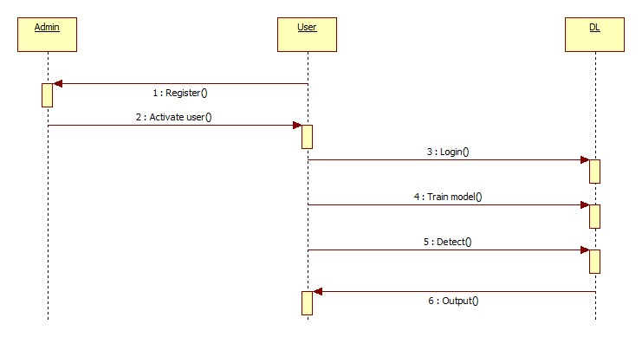
5.3 Sequence Diagram
Owner Actions:
Enroll Store Employees
Manage Employee Records
Store Manager Actions:
Upload Image.
Receive Low Stock Notification
Enroll Store Employees
Manage Employee Records
RCNN Actions:
Receive & Process Image: Receives the uploaded image and processes it using Faster R-CNN for empty shelf detection.
Inventory Data Extraction: Extracts labeled items and corresponding stock levels from the image.
Inventory System Actions:
Update Inventory: Uses the extracted data to update the inventory database.
Threshold Check & Recommendations: Compares stock levels against thresholds and generates restock recommendations.
Low Stock Notification: Sends alerts or notifications when stock falls below the defined threshold.
Fig 5.3 Sequence of the store management

Slide 16
6. Testcases
S.no | Test Case | Excepted Result | Result | Remarks(IF Fails)
1. | User Register | If User registration successfully. | Pass | If already user email exist then it fails.
2. | User Login | If Username and password is correct then it will getting valid page. | Pass | Un Register Users will not logged in.
3. | Admin Add the Data | A new record will added to our dataset. | Pass | Data types not match then this case failed
4. | Data Cleaning | Data will be cleaned. | Pass | The data will be in int or float format, otherwise algorithm will not work..
5. | Mean Square error calculates | Means Square error calculation | Pass | If noisy data there then the result will not accurate
6. | Mean Absolute Error calculation | Selected Model Mean Absolute Error calculated and sent to browser. | Pass | If noisy data there then the result will not accurate.

Slide 17
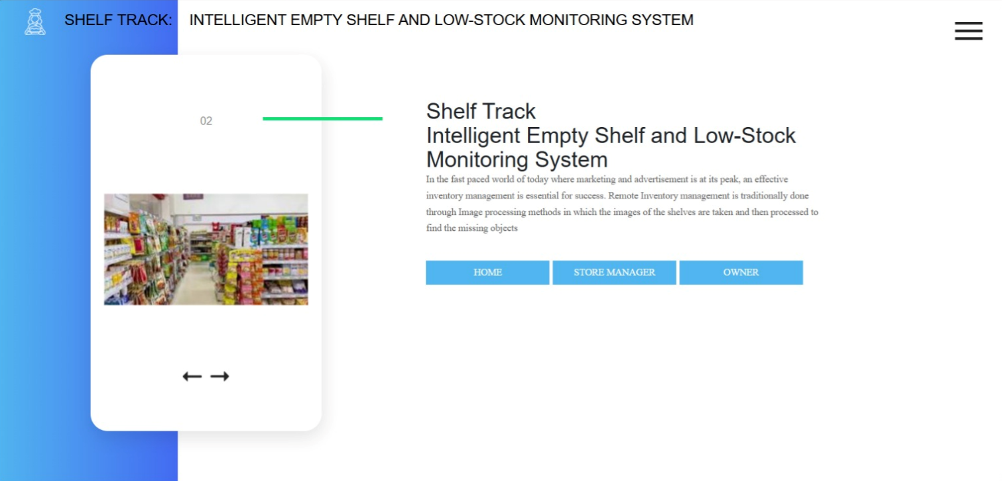
7. RESULTS
Fig 7.1 User Interface for Image Upload in a Web Application

Slide 18
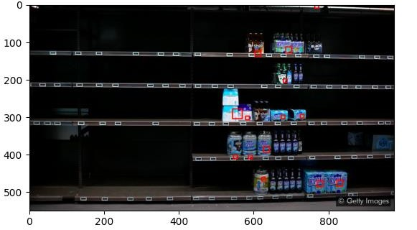
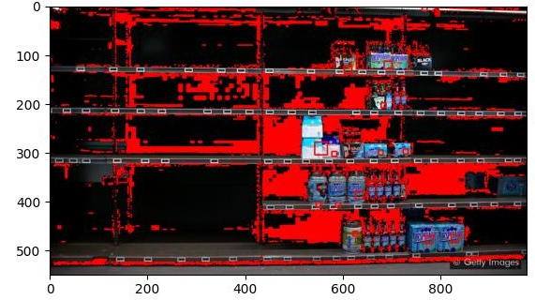
Shelf Detection
Top Image:
Shows a partially stocked shelf in its original form.
The Faster R-CNN model analyzes shelf space under varying lighting and product arrangements.
Bottom Image:
Highlights empty or near-empty areas in red.
These detected regions indicate where stock is low or missing.
Key Observations:
The system effectively pinpoints empty shelf regions, even under low-light conditions.
By isolating these areas, subsequent OCR-based labeling and stock quantification steps are more accurate and efficient.
Automated alerts are generated whenever significant empty regions are identified, prompting timely restocking actions.
fig 7.3 Shelf Detection System in a Workplace Environment

Slide 19
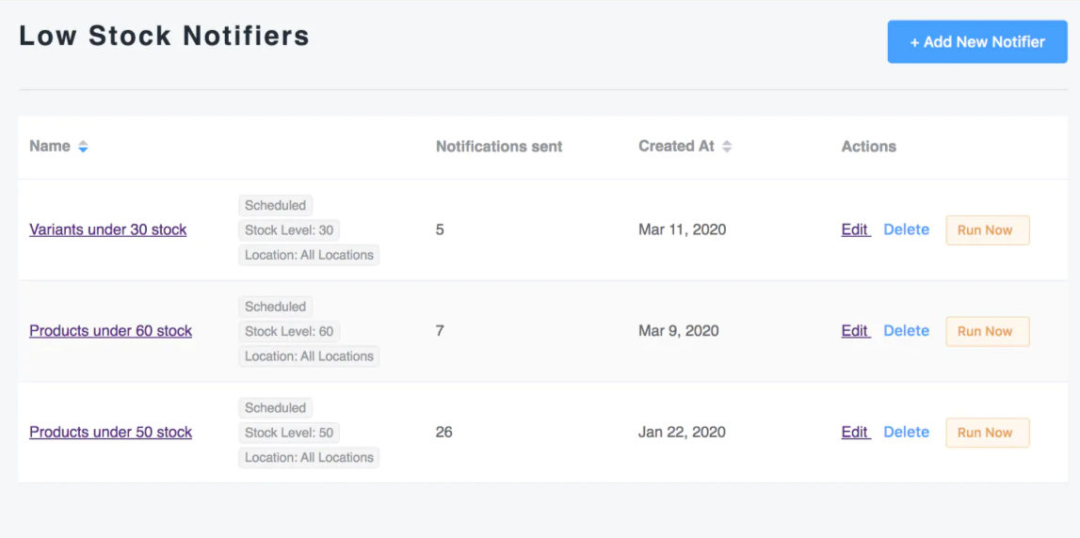
Fig 7.2 Low Stock Notification

Slide 20
8. Conclusion
Efficient & Privacy-Conscious Solution:
Employs a pre-trained Faster R-CNN model for empty shelf detection (99% efficiency).
Hybrid OCR-CNN module accurately recognizes item labels and quantities.
Ensures minimal manual intervention and addresses privacy concerns by focusing on shelves rather than customers.
Real-Time Stock Monitoring & Automation:
Actionable restocking recommendations generated promptly.
Reduces labor costs and operational overhead.
Key Takeaways & Future Scope:
High accuracy and privacy-centric design.
Future enhancements may improve detection speed and scalability.
Potential for broad applicability in diverse retail settings.
IoT Sensors
cloud-based ML deployment

Slide 21
9. References
[1] Higa K, Iwamoto K. “Robust Shelf Monitoring Using Supervised Learning for Improving On-Shelf Availability in Retail Stores”. Sensors (Basel). 2019 Jun 17;19(12):2722. doi: 10.3390/s19122722.
[2] Bottani, E.; Bertolini, M.; Rizzi, A.; Romagnoli, G. Monitoring on-shelf availability, out-of-stock and product freshness through RFID in the fresh food supply chain. Int. J. RF Technol. Res. Appl. 2017, 8, 33–55.
[3] Michael, K.; McCathie, L. The Pros and Cons of RFID in Supply Chain Management. Proceedings of the 4th International Conference on Mobile Business (ICMB), Sydney, NSW, Australia, 11–13 July 2015; pp. 623–629.
[4] Moorthy, R.; Behera, S.; Verma, S.; Bhargave, S.; Ramanathan, P. Applying image processing for detecting on-shelf availability and product positioning in retail stores. Proceedings of the ACM International Conference Proceeding Series, Kochi, India, 10–13 August 2015; pp. 451–457.
[5] Yilmazer, R.; Birant, D. “Shelf Auditing Based on Image Classification”. Sensors 2021, 21(2), 327; https://doi.org/10.3390/s21020327.
[6] Zhu, X. Semi-Supervised Learning. Encyclopedia of Machine Learning and Data Mining; Springer: Berlin/Heidelberg, Germany, 2017; Volume 3, ISBN 9781489976871.
[7] Satapathy, R.; Prahlad, S.; Kaulgud, V. Smart Shelfie—Internet of shelves: For higher on-shelf availability. Proceedings of the 2015 IEEE Region 10 Symposium TENSYMP, Ahmedabad, India, 13–15 May 2015; pp. 70–73.
[8]Kejriwal, N.; Garg, S.; Kumar, S. Product counting using images with application to robot-based retail stock assessment. Proceedings of the IEEE Conference on Technologies for Practical Robot Applications, Woburn, MA, USA, 11–12 May 2015; pp. 1–6.

Slide 22
THANK YOU

